Slide 1
EDA ON IRIS DATASET
Piyush Pratap Singh

Slide 2
Data Gathering
* Collection of data
Data Cleaning
* Noisy value
* Outlier removal
Exploration of data
* Descriptive Statistics
* Graph
Analysis
* Explore relationship btw variable
* Compare groups
Data Preparation
* Categorization/grouping
* Redundancy
* Removal of irrelevant columns

Slide 3
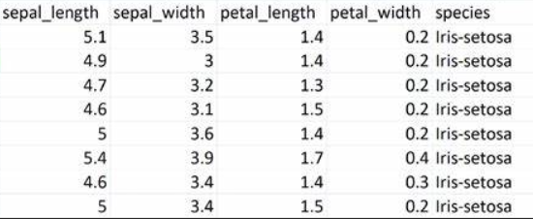
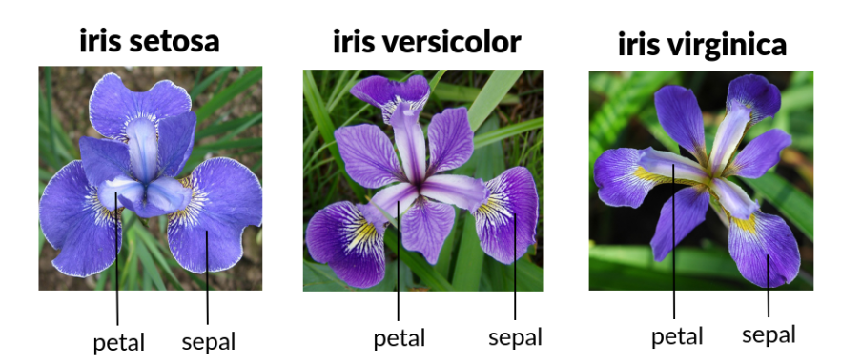
About Datasets
The Iris flower data set or Fisher's Iris data introduced by the British statistician and biologist Ronald Fisher
The dataset contains a set of 150 records under five attributes - sepal length, sepal width, petal length, petal width and species.

Slide 4
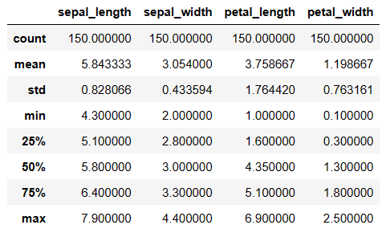
To get the overview about the statics columns
Five - point Summary about the numerical data
Mean
Median
Minimum
Maximum
Count

Slide 5
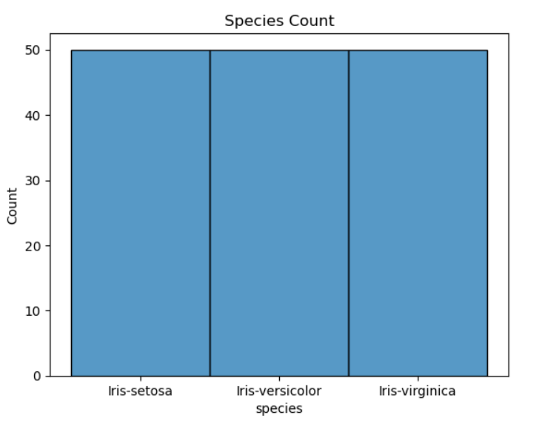
About label/dependent Variable
Insights
The visualizes that species are well balanced
Each species ( Iris virginica, setosa, versicolor) has 50 as it’s count or 33.3% for each category of class

Slide 6
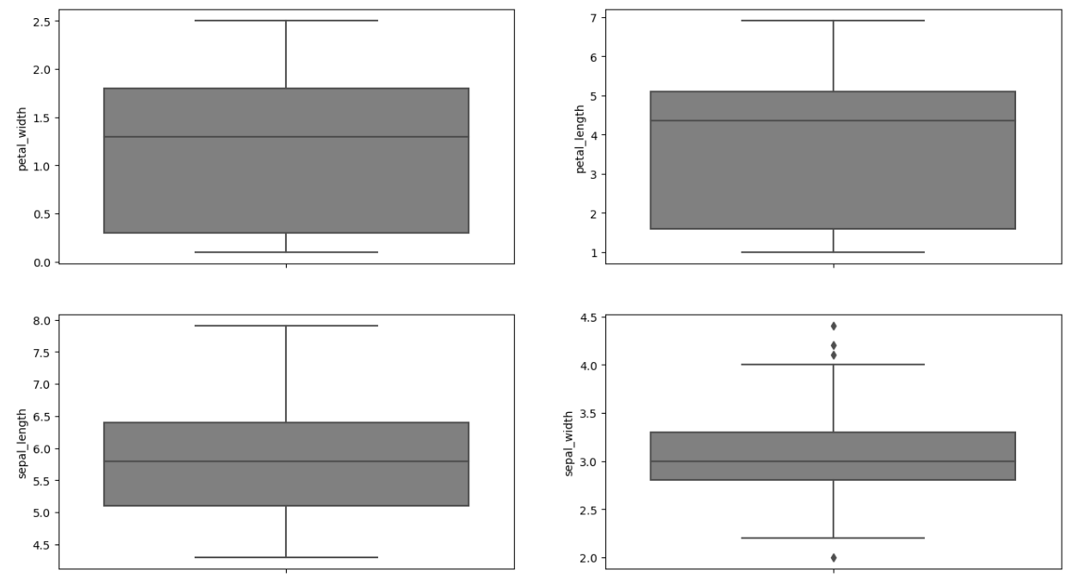
QUARTILE & OUTLIER ANALYSES
Box and whisker plots
give idea about distribution of input attributes
Observation
Sepal width has some outlier deal with it appropriately

Slide 7
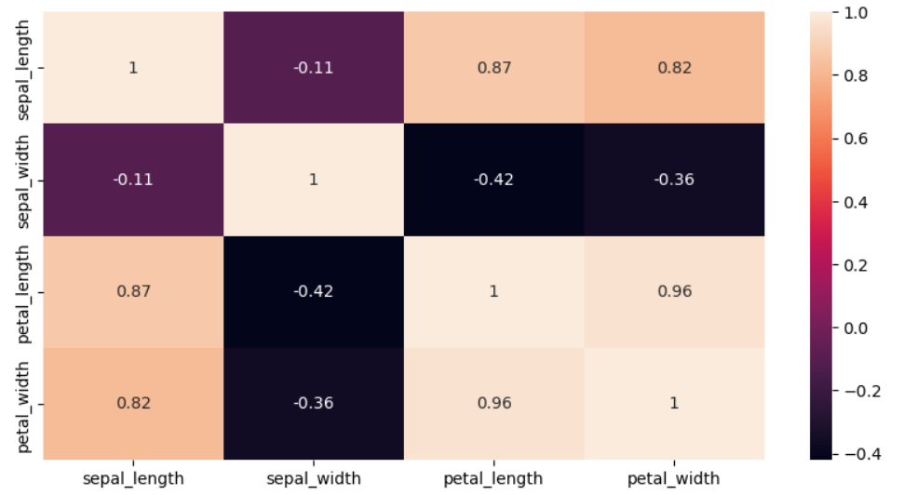
Correlation:
Sepal Length and Sepal Width features are slightly correlated with each other
Feature must be independent for making good model

Slide 8
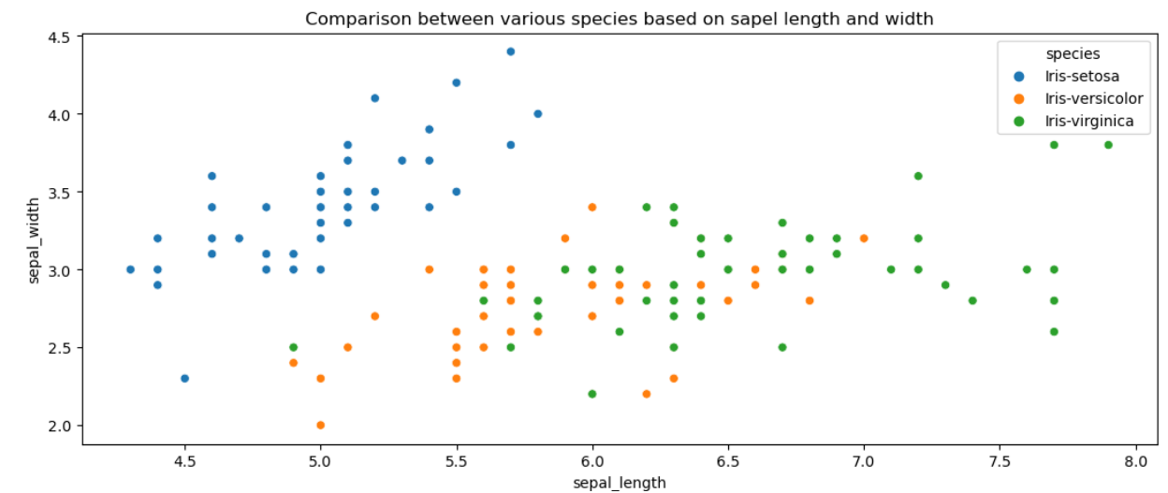
SCATTER PLOT Comparison between various species based on sepal length and sepal width
Observation :
Iris Setosa species has smaller sepal length but higher width.
Versicolor lies in almost middle for length as well as width
Virginica has larger sepal lengths and smaller sepal widths

Slide 9
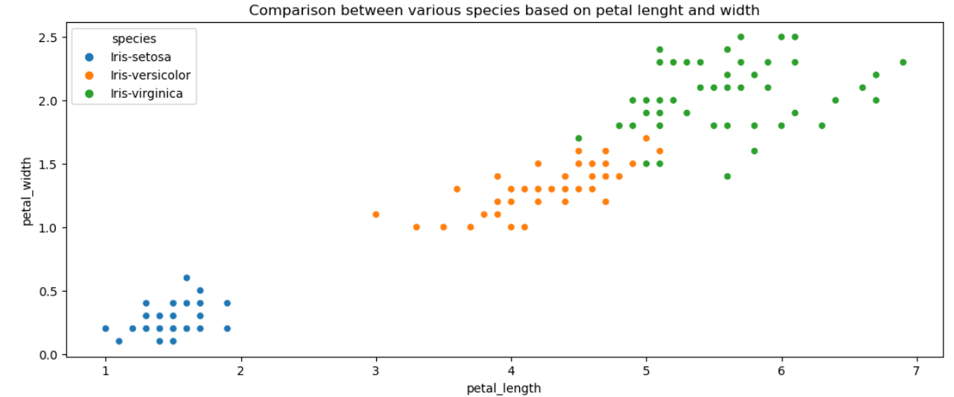
SCATTER PLOT Comparison between various species based on petal length and petal width
Observation :
Setosa species have the smallest petal length as well as petal width
Versicolor species have average petal length and petal width
Virginica species have the highest petal length as well as petal width

Slide 10
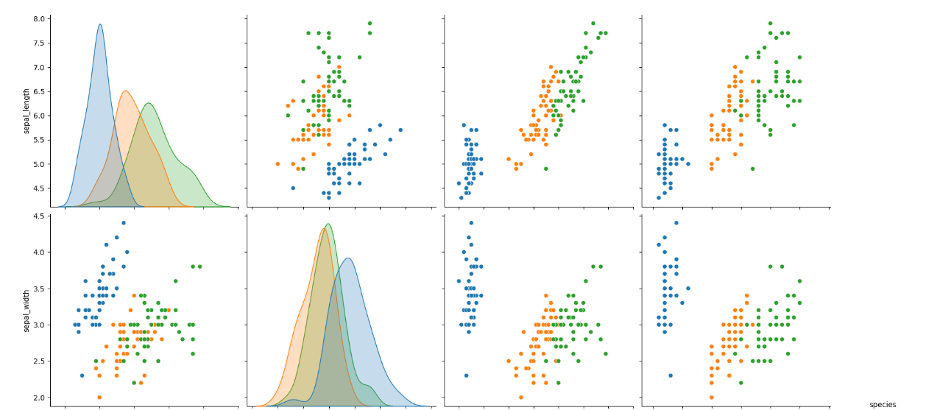
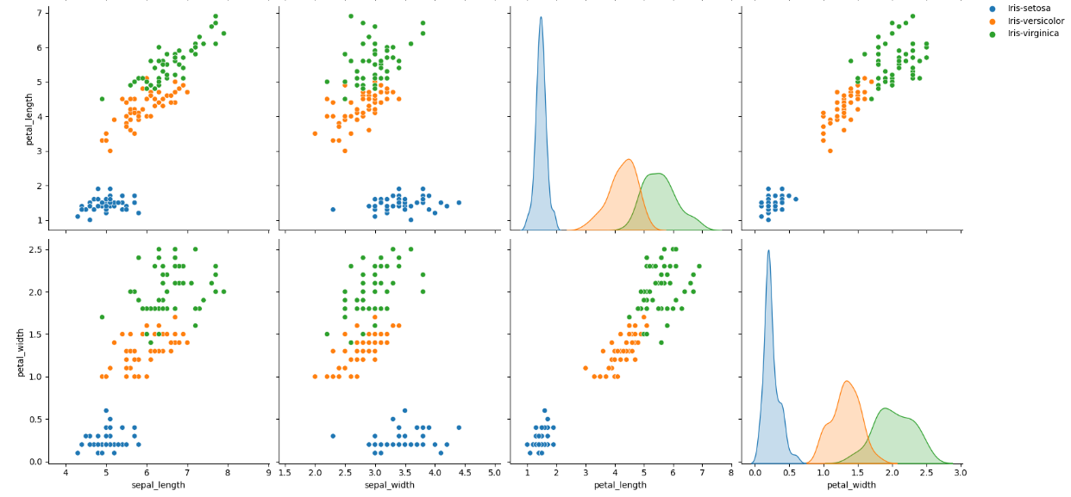
SCALER PLOT FOR ALL ATTRIBUTES
Observation :
High co relation between petal length and width columns.
Setosa has both low petal length and width
Versicolor has both average petal length and width
Virginica has both high petal length and width.
Sepal width for setosa is high and length is low.
Versicolor have average values for for sepal dimensions.
Virginica has small width but large sepal length

Slide 11
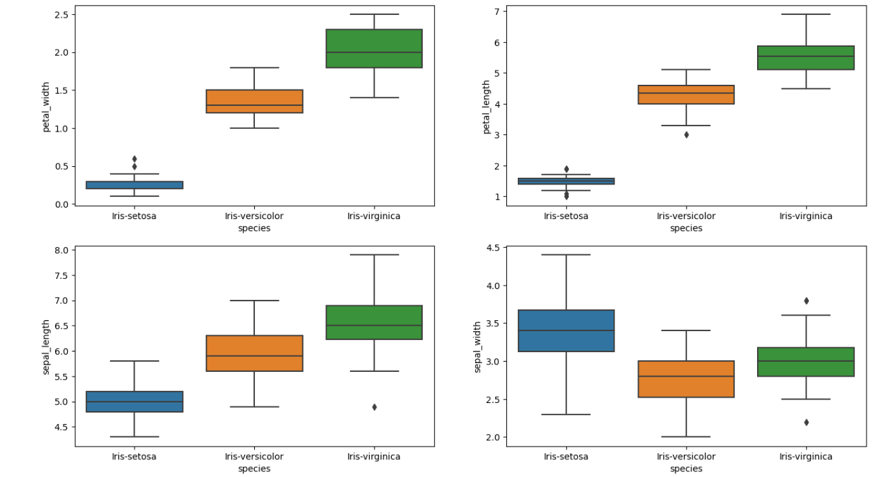
Box plots to know about distribution boxplot to see how the categorical feature “Species” is distributed with all other four input variables
Observation :
Setosa is having smaller feature and less distributed
Versicolor is distributed in a average manner and average features
Virginica is highly distributed with large no .of values and features
Clearly the mean/ median values are being shown by each plots for various features(sepal length & width, petal length & width)

Slide 12
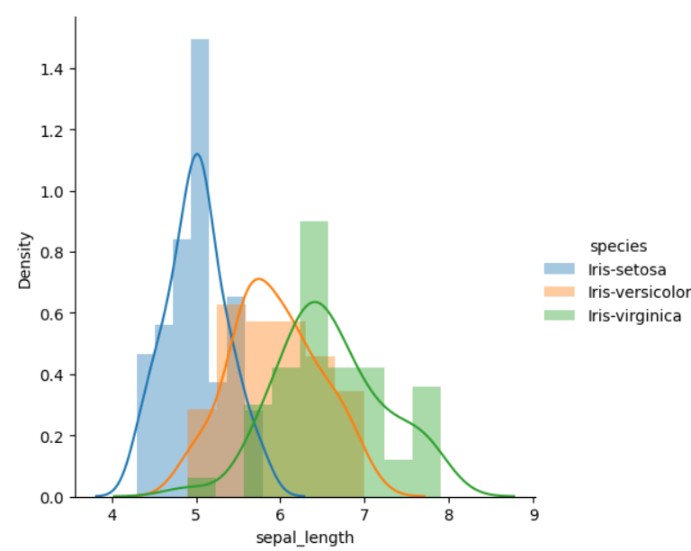
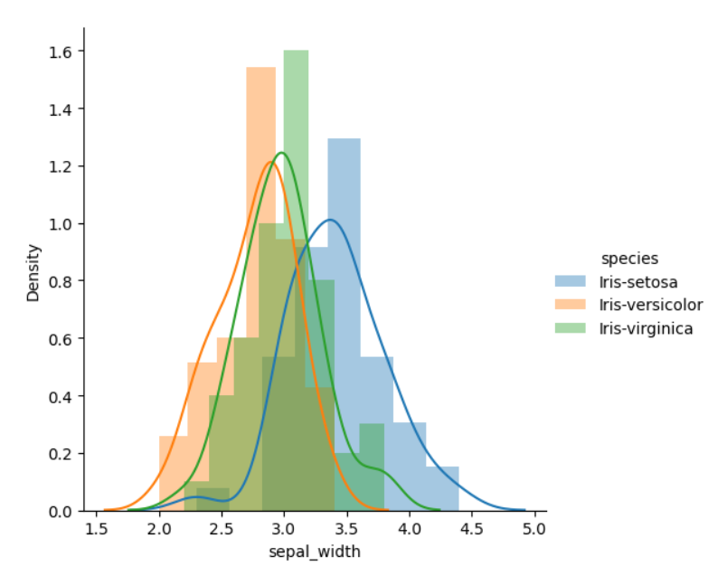
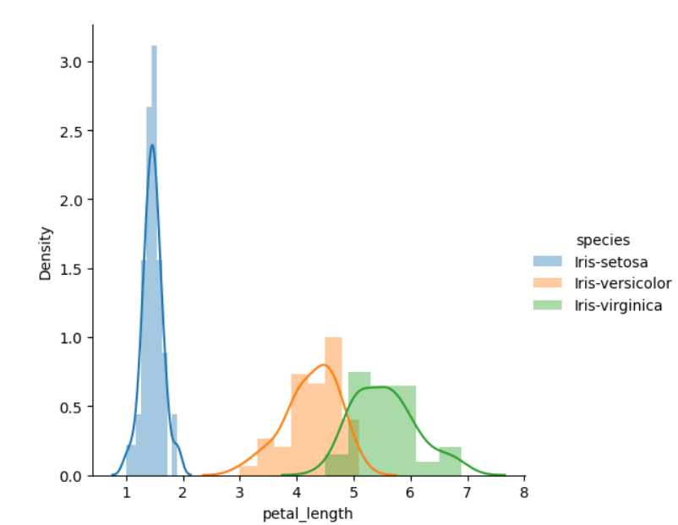
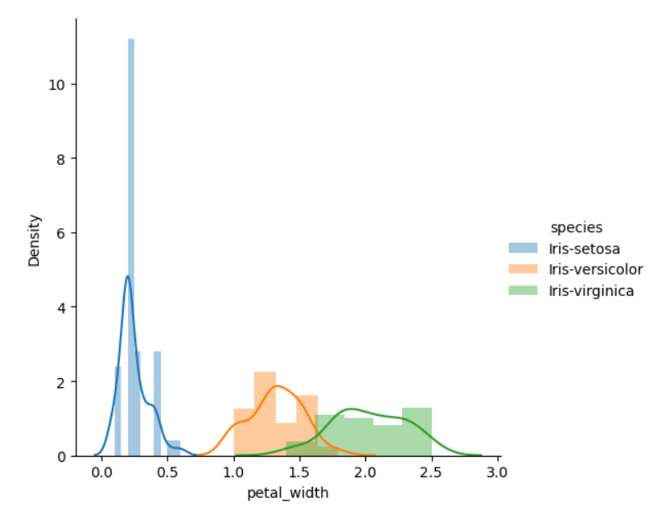
Plotting the Histogram & Probability Density Function (PDF)
plotting the probability density function(PDF) with each feature as a variable on X-axis and it’s histogram and corresponding kernel density plot on Y-axis.
Observation :
Plot 1 shows that there is a significant amount of overlap between the species on sepal length, so it is not an effective Classification feature
Plot 2 shows that there is even higher overlap between the species on sepal width, so it is not an effective Classification feature
Plot 3 shows that petal length is a good Classification feature as it clearly separates the species . The overlap is extremely less (between Versicolor and Virginica) , Setosa is well separated from the rest two
Just like Plot 3, Plot 4 also shows that petal width is a good Classification feature . The overlap is significantly less (between Versicolor and Virginica) , Setosa is well separated from the rest two

Slide 13
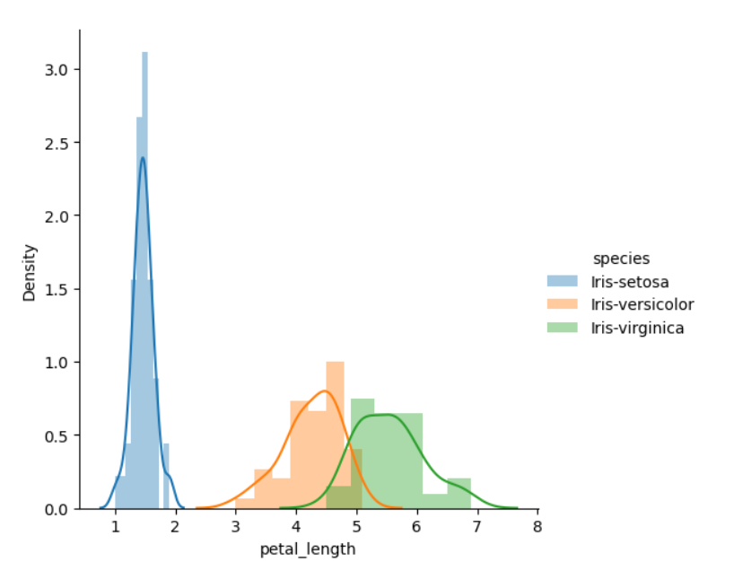
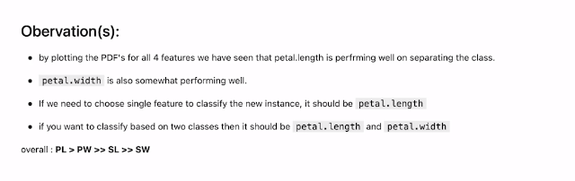
Choosing Plot 3 (Classification feature as Petal Length)
to distinguish among the species . The pdf curve of Iris Setosa ends roughly at 2.1
Observation :

Slide 14
Now we are ready & we can clean data & apply Machine learning classification algorithms for predicting the species

